Slide 1
CSE 3100: Systems Programming
Lecture 9 : Input/Output and Files
Department of Computer Science and Engineering
University of Connecticut

Slide 2

Review of Some Previous Lecture Concepts…

Slide 3
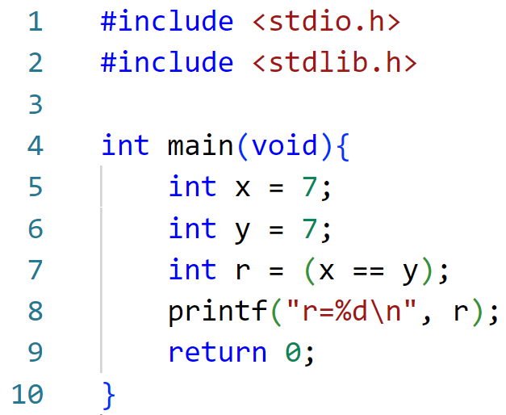
Question 0: What will be printed?
A) r=7
B) r=0
C) r=1

Slide 4
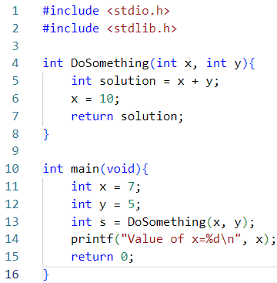
Question 1: What will be printed?
A) x=10
B) x=7
Why? Primitives are passed by VALUE to functions.

Slide 5
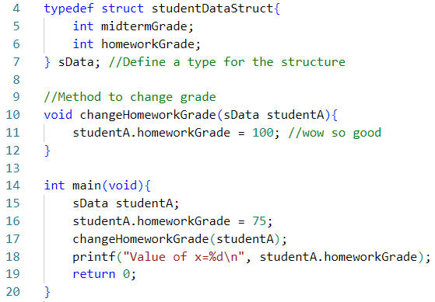
Question 2: What will be printed?
A) x=75
B) x=100
Why? Structures variables are passed by VALUE to functions.

Slide 6
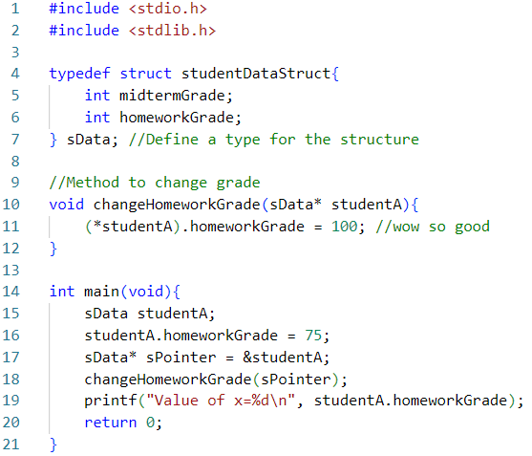
Question 3: What will be printed?
A) x=75
B) x=100
Why? The pointer to the structure allows us to manipulate the original variable.

Slide 7
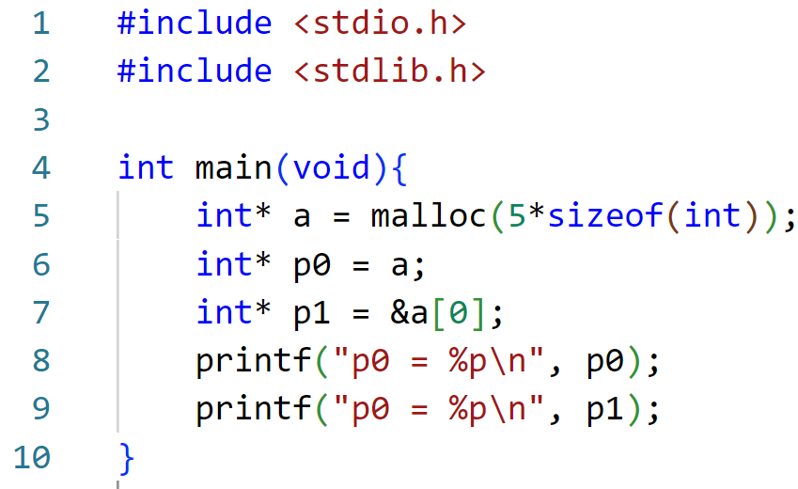

Question 4: Are p0 and p1 the same?
A) Not same.
B) Same.

Slide 8
1. Error Handling
Today’s Lecture Topics
2. Files and Input/Output

Slide 9
1. Error Handling

Slide 10
errno
Most C library functions can “fail”
  When they do, they return a flag reporting failure… (-1)
  Some set a global variable to report the exact error code
errno
// To use errno, include <errno.h>
Check manual page to interpret the error code
Print a more descriptive message with perror()
  void perror(const char *str);

Slide 11
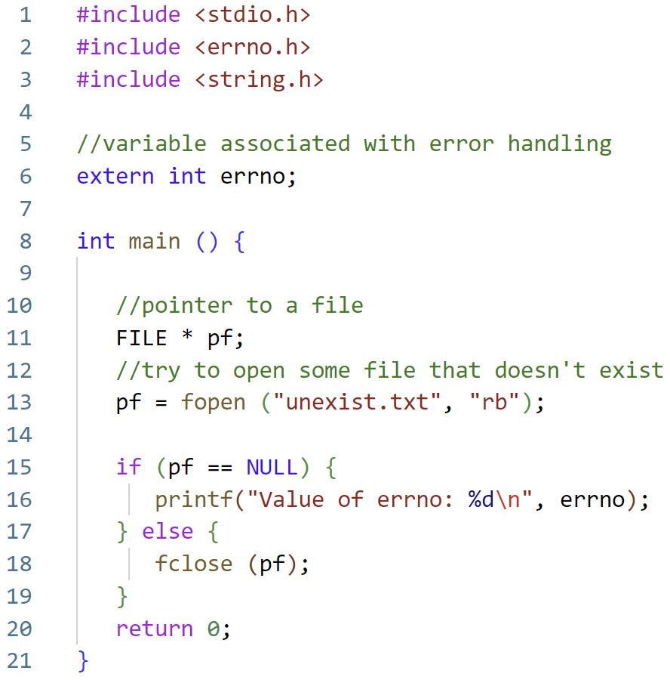
Error Example
Code Example From: https://www.tutorialspoint.com/cprogramming/c_error_handling.htm

Slide 12
Error Example
Try to open some file that doesn’t exist.
We want to create an error on purpose to see the value of errno that is printed out.
Code Example From: https://www.tutorialspoint.com/cprogramming/c_error_handling.htm

Slide 13
Error Example
If we don’t have the file (NULL) then print out the value of errno.
Otherwise just close the file.
It is important to note: in this example we DO NOT have the file (on purpose).
Code Example From: https://www.tutorialspoint.com/cprogramming/c_error_handling.htm

Slide 14

Error Example
Errno #2
C Programmer
Code Example From: https://www.tutorialspoint.com/cprogramming/c_error_handling.htm

Slide 15
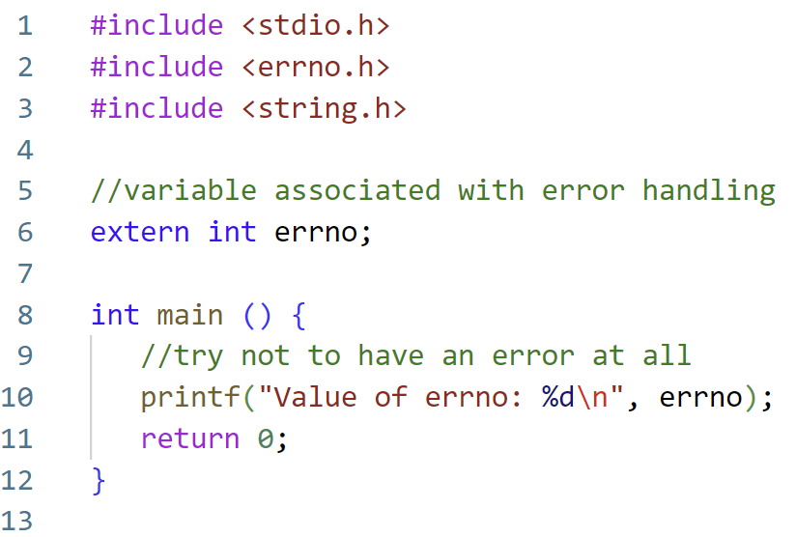
Error Example: What does no error look like?
Ok so we know 0 means no error. But do we want to actually memorize all the C error codes?

Slide 16
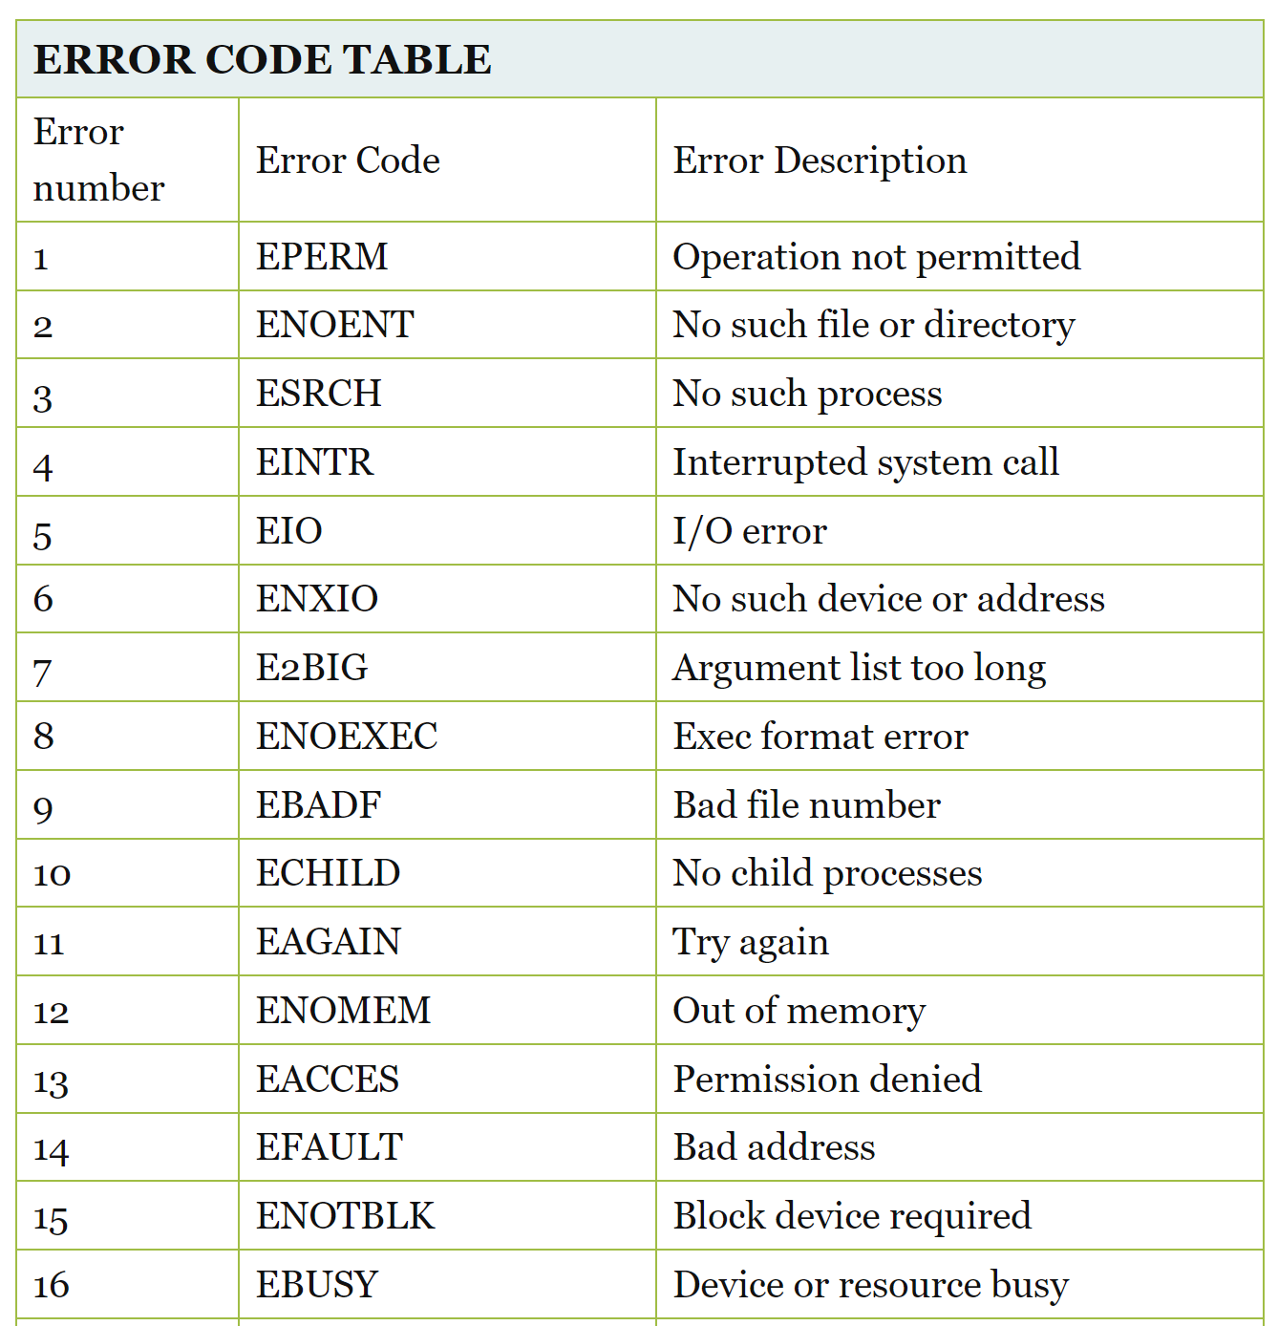
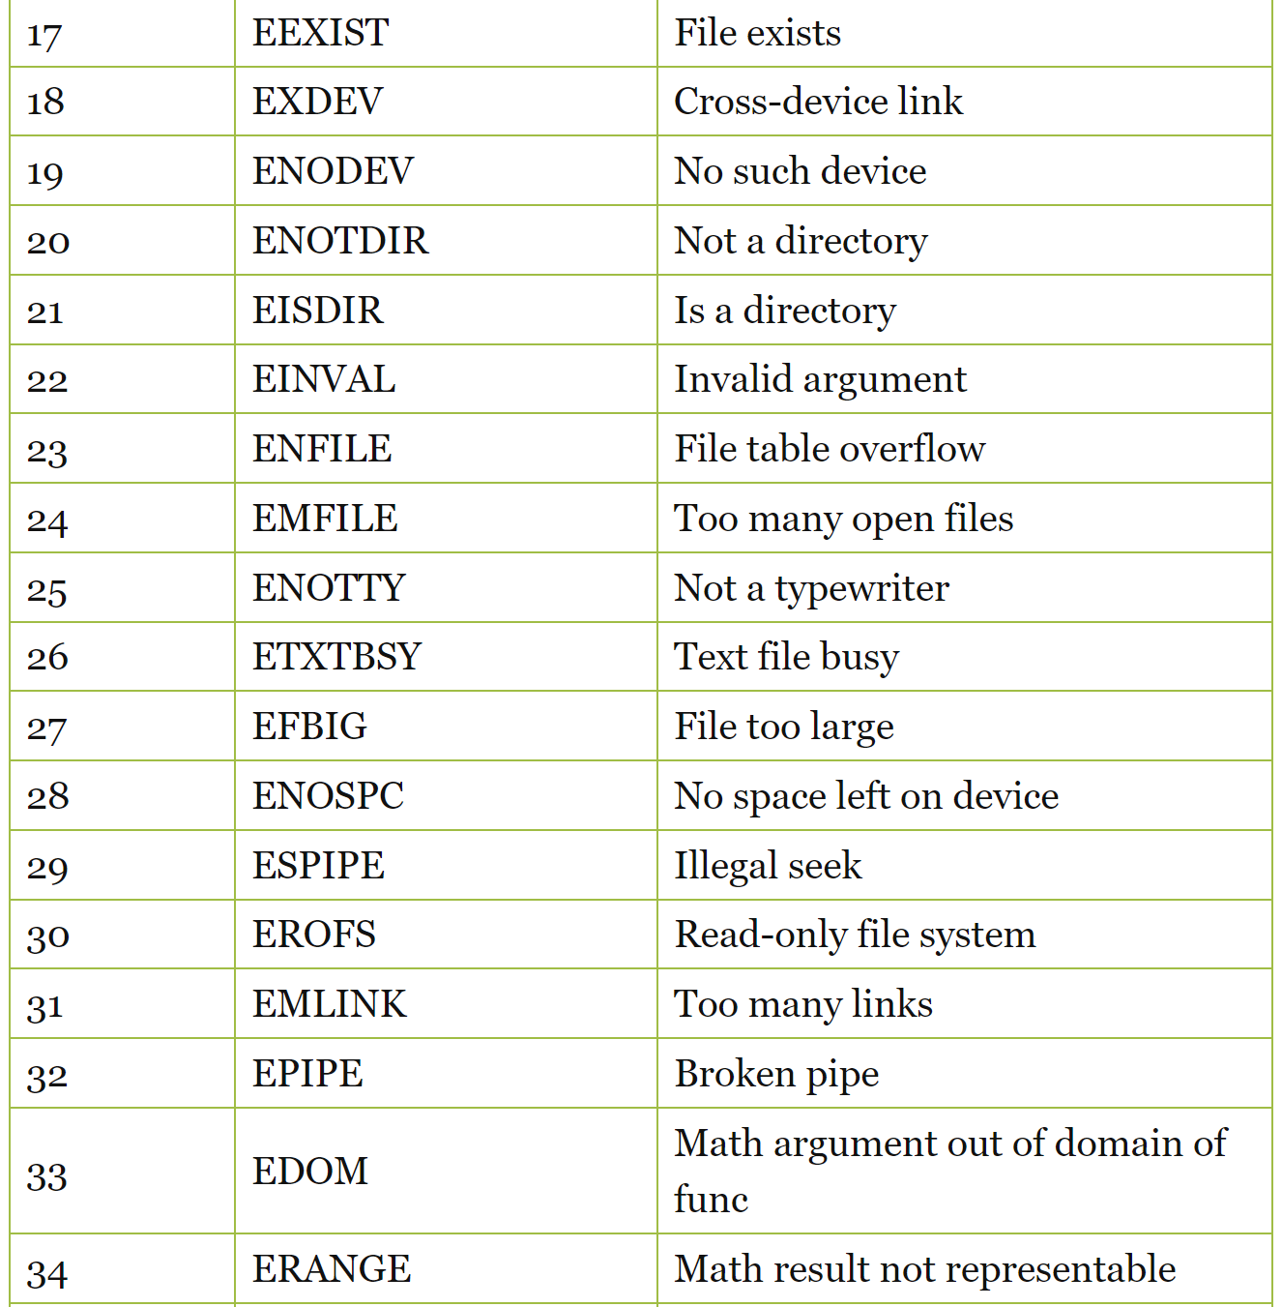

Do we want to actually memorize all the C error codes?
Yes. For the exam I will ask you to write all 131 error codes from your own memory (first 34 shown here):
Just kidding!

Slide 17
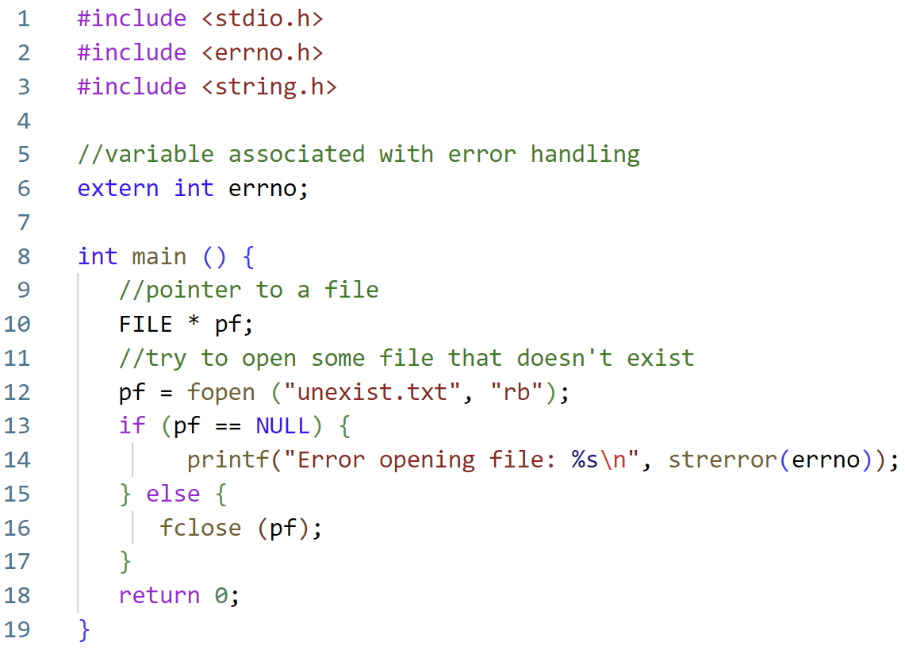
A more readable error message:

Slide 18
2. Files and Input/Output

Slide 19

Files and Directories
A file is an object that stores information, data, etc.
Example:
Files you create with an editor (.c, .h, Makefile, readme, etc.)
Executable generated by the compiler, and gcc itself
Other devices, like screen, keyboard, …
In Linux, files are organized in directories
  A directory can have subdirectories and files
  The top directory is /
A path specifies the location of file/directory in the file system
/home/john
In Unix/Linux, everything is a file
A file
A file
A file
Files

Slide 20
The stdio library
#include <stdio.h>
Declares FILE type and function prototypes
  FILE is an opaque type (system dependent) for operating on files
    It is a structure, but do not try to change it directly!
  Use library functions to access FILE objects, via pointers (FILE *)
Defines “standard” streams stdin, stdout, stderr
  Created automatically when program starts
  They are files!
The library is linked automatically by the compiler
They are FILE *

Slide 21
Files and I/O API
In C, a file is simply a sequential stream of bytes
The “f” family of functions (fopen, fclose, fread, fgetc, fscanf, fprintf,…) are C library functions to operate on files
  All these use a FILE* abstraction to represent a file
  The C library provides buffering
    That's why sometimes you do not see output of printf immediately

Slide 22
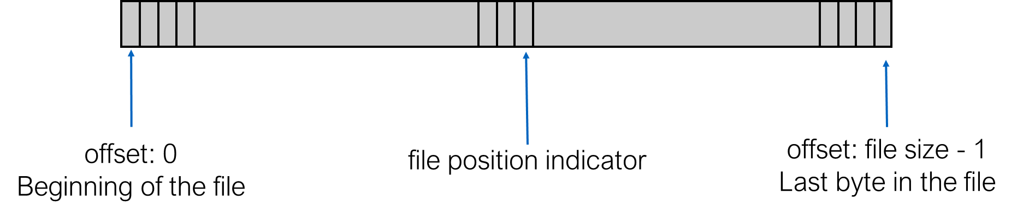
File as stream of bytes
Before use a file must be “open”
  This sets a position indicator for reading and/or writing
Each read/write starts from current position, and moves the indicator
  Writing after last byte increases the file size
Position indicator can also be changed with fseek
All open files are closed when program ends
  Good practice to close explicitly when no longer needed

Slide 23
Opening Streams
FILE* fopen( const char *filename, const char *mode);
  Open the file filename in mode as a stream of bytes
  Returns a pointer to FILE (FILE *) or NULL (and errno is set)
  Mode
    “r” : Reading mode
    “r+” : Read and write
    “w” : Writing mode, file is created or truncated to zero length
    “w+” : Read and write, but the file is created or truncated
    “a” : Append mode, the file is created if it does not exist
    “a+” : Read and append, the file is created if it does not exist. Reading starts at beginning, but writing done at the end

Slide 24

Closing Streams
a file
int fclose(FILE *stream);
  Close a stream
  Returns
    0 if it worked
    EOF if there was a problem (and errno is set)

Slide 25
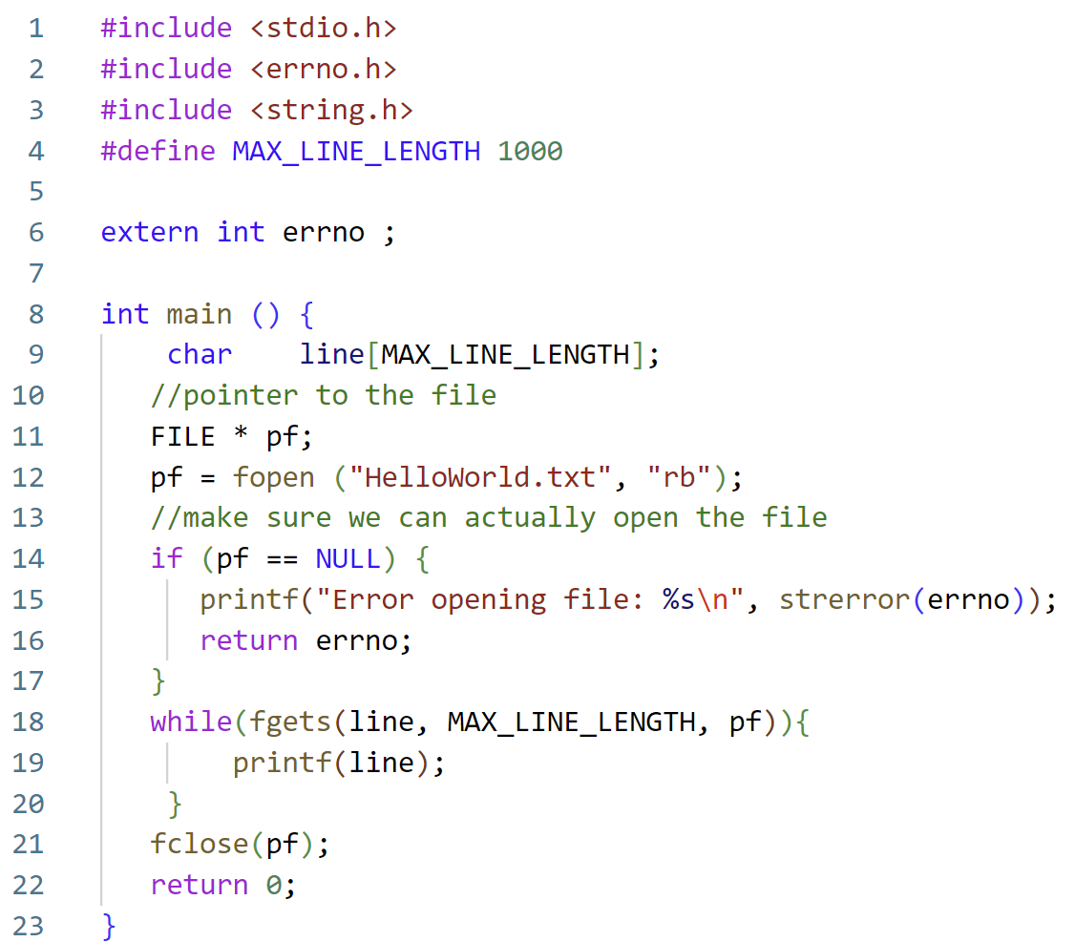
Simple File Reading Example
Read in a maximum number of character lines from a text file.

Slide 26

What does the file “HelloWorld.txt” look like?
HelloWorld.txt
When you create a very complicated file:
Hello
World
My
Name
Is
Apple

Slide 27
Simple File Reading Example
Error handling as we previously discussed, make sure the file is readable.

Slide 28
Simple File Reading Example
Create a file pointer and use fopen to point to the file.
Use fgets to keep reading lines of the file until we reach the end or max length.

Slide 29
Who is fgets?
char *fgets(char *str, int n, FILE *stream)
The C library function char *fgets(char *str, int n, FILE *stream) reads a line from the specified stream and stores it into the string pointed to by str.
It stops when either (n-1) characters are read, the newline character is read, or the end-of-file is reached, whichever comes first.
Source: https://www.tutorialspoint.com/c_standard_library/c_function_fgets.htm

Slide 30
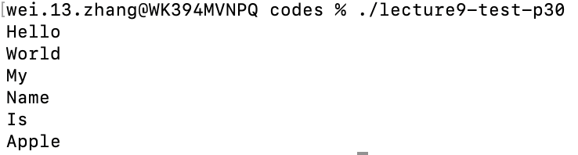
Simple File Reading Example

Slide 31
Byte Sized Reading
In the previous coding example we looked at reading an entire line.
What if we want to read bytes at a time?
int fgetc( FILE *stream);
int fputc(int c, FILE *stream);
Read or write one (ASCII) character (8-bits) at a time
  Can be slow for large files
fgetc reads a character from the stream and returns the character just read in (as unsigned char extended to int)
    Returns EOF when at the end of file or on error
fputc writes the character received as argument to the stream and returns the character that was just written out
    Returns EOF on error

Slide 32
getc / putc and ungetc
int getc(FILE *stream);
int putc(int c, FILE *stream);
  Same as fgetc/fputc except they may be implemented as macros
  Use fgetc/fputc unless you have strong reasons not to
int ungetc(int c, FILE *stream);
  Pushes last read char back to stream, where it is available for subsequent read operations
  Only one pushback guaranteed

Slide 33
getchar / putchar
int getchar(void)
// same as fgetc(stdin)
  Reads a character from stdin
  Returns the character just read in, or EOF on end-of-file or errors
int putchar(int c)
// same as fputc(c, stdout)
  Writes the character received as argument on stdout
  Returns the character that was just written out, or EOF on errors

Slide 34
Formatted output
int fscanf(FILE *stream, const char *format, ...);
int fprintf(FILE *stream, const char *format, ...);
  Formatted input from file and output to file
  Like scanf()/printf(), but not from stdin or to stdout

Slide 35
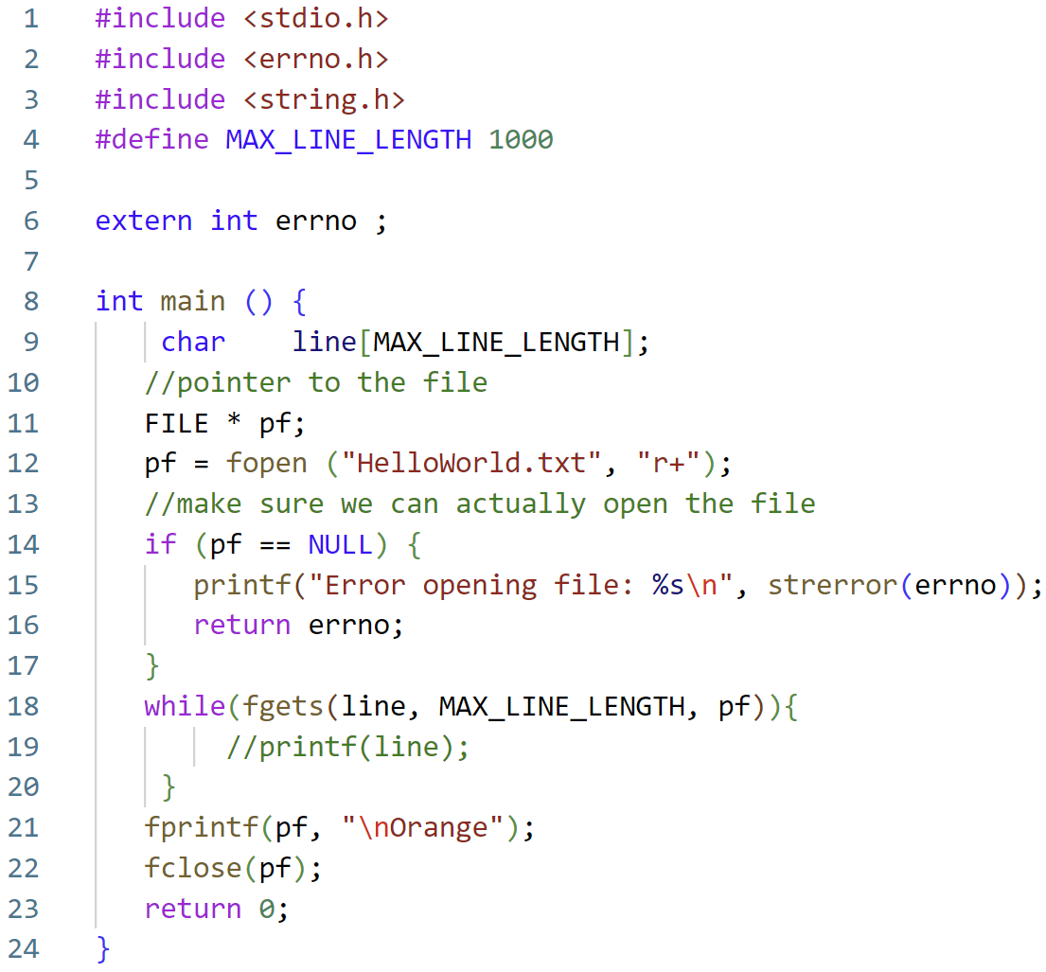


Fprintf Example
BEFORE the code is run.
AFTER the code is run.

Slide 36
Moving file position indicator
long ftell(FILE *stream);
  Read file position indicator
  Return -1 on error
int fseek(FILE * stream, off_t offset, int whence);
  Set the file position indicator
  Return 0 on success and -1 on error
Example:
fseek(fp, 0, SEEK_SET); // move to the beginning
fseek(fp, 200, SEEK_CUR); // move forward 200 bytes
fseek(fp, -1, SEEK_END); // move to the last byte

Slide 37
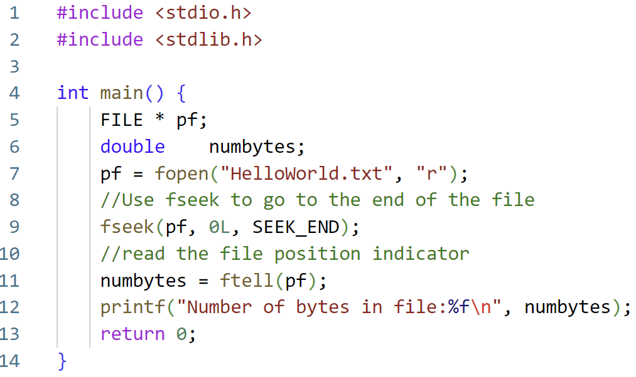
Code Example: Finding the size of a file
Source: https://www.tutorialkart.com/c-programming/c-read-text-file/

Slide 38
Related I/O Function Slides
//Check if end-of-file is set (after a read attempt!)
int feof(FILE * stream);
//Force write of buffered data
int fflush(FILE * stream);
int fputs(const char *str, FILE *out)
  Writes the string str to out, stopping at ‘\0’
  Returns number of characters written or EOF
size_t fread (void *ptr, size_t sz, size_t n, FILE *stream);
size_t fwrite(void *ptr, size_t sz, size_t n, FILE *stream);
  Read / write a sequence of byte from/to a stream
  Return the number of items read or written
    If smaller than n, EOF or error

Slide 39
Figure Sources
https://cdn.vox-cdn.com/thumbor/VKx8R0U9BKwV9SE2_eaVwJtywjU=/0x0:500x375/1400x1050/filters:focal(158x110:238x190):format(jpeg)/cdn.vox-cdn.com/uploads/chorus_image/image/59741997/n4scgse21iuz.0.jpg
https://www.thegeekstuff.com/2010/10/linux-error-codes/
https://i.kym-cdn.com/photos/images/facebook/001/100/963/ab8.jpg
http://www.quickmeme.com/meme/3upt4q
https://live.staticflickr.com/699/32421179826_69211d9189_b.jpg
https://external-preview.redd.it/6oAehEdLMEkhf2vzyahMneljSakPn7PvkG-KmykG7UY.jpg?auto=webp&s=47c3d3654cfe2b078a809c3d41d62ec60be1ecb2

